Slide 1

Mentor Mash
Perfect

Slide 2
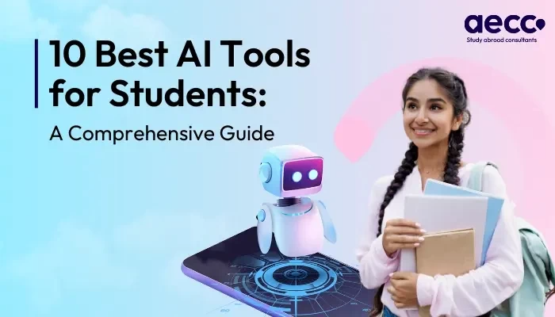
Mentor Mash
Best AI Tool
For Students:
A Comprehensive Guide

